Slide 1
Types of Memorandum

Slide 2
Information Memo
Problem Solving Memo
Persuasion Memo
Internal Memo Proposal
Directive Memo
Response to an Inquiry Memo
Trip Report Memo
Field Report/Lab Report Memo

Slide 3

Information Memo
Information memo is used to deliver or request information or assistance.
Structure:
First part provides main idea.
Second part expands on the details.
Third part outlines the action required.

Slide 4
To: All employees in the procurement department
From: Barry Buttonwood, Assistant Manager, Staff Training and Development
Date: August 22, 2020
Subject: Mandatory training for new software
You are all aware of the company's recent adoption of a new supply chain management software. The company invested in the new application to improve communication with our vendors, enhance order tracking and reduce delays to the barest minimum to save cost and boost efficiency.
We will hold a training workshop to familiarize department staff with the new software on August 25, 2018. We hope this training will allow everyone to make a smooth transition to the new application. All departmental staff must attend the training event.

Slide 5
Problem Solving Memo
This type of memo suggests a specific action to improve a situation.
Structure:
First part states the problem and gets right to it.
Second part analyzes the problem with details pertaining to who and what is affected by the problem.
Third part makes a recommendation. When making a recommendation, include not only the positive details but also the drawbacks and diffuse them yourself to minimize the problem.

Slide 6
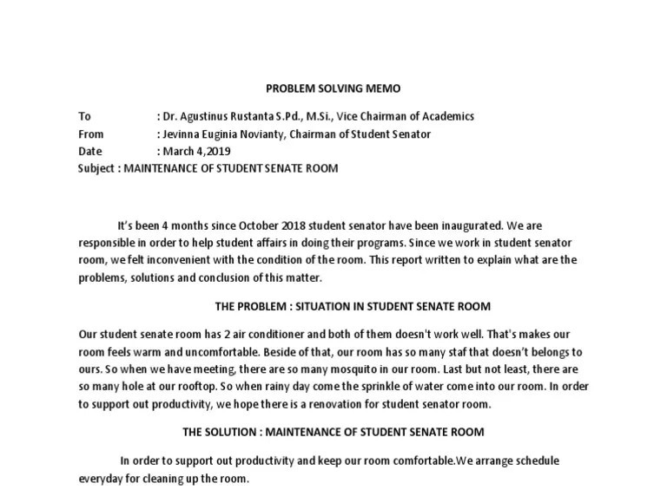

Slide 7
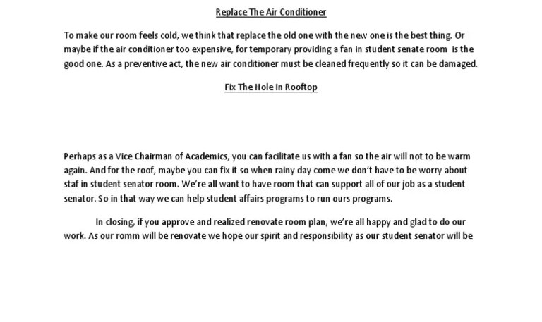

Slide 8
Persuasion Memo
Persuasion memo is used to encourage the reader to cooperate in a desired action.
Structure:
First part begins with an agreeable point
Second part introduces the idea
Third part states benefit to the reader
Fourth part outlines the action required
Final part ends with a call to action

Slide 9
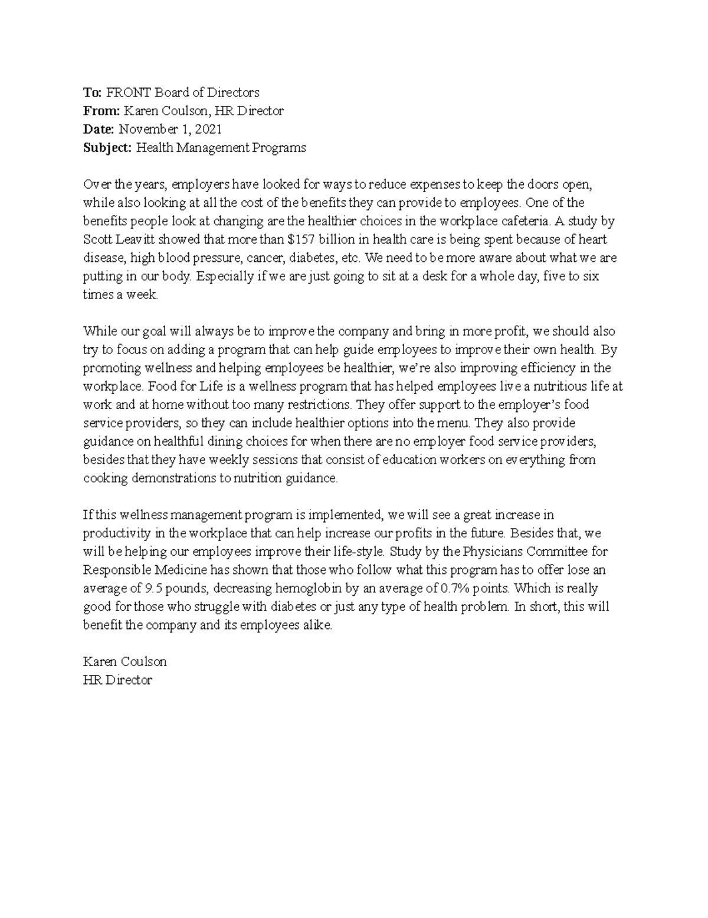

Slide 10
Internal Proposal Memo
Such a memo is used to convey suggestions to senior management.
Structure:
First part states reason for writing
Second part outlines present situation and states writer's proposal
Third part describes advantage(s)
Fourth part mentions and diffuses disadvantage(s)
Fifth part ends with a call to action

Slide 11
Directive Memo
A directive memo states a policy or procedure you want the reader or co-worker to follow.
Structure:
Length depends on space required for explanation. This is determined by nature of the audiences.
The memo should begin with a clear and concise statement of purpose.
Example: The purpose of this memo is to let all members of the ABC Department know that doughnuts will be provided every Friday morning at 9:00 AM.
Purpose is followed by statements providing a rationale.

Slide 12
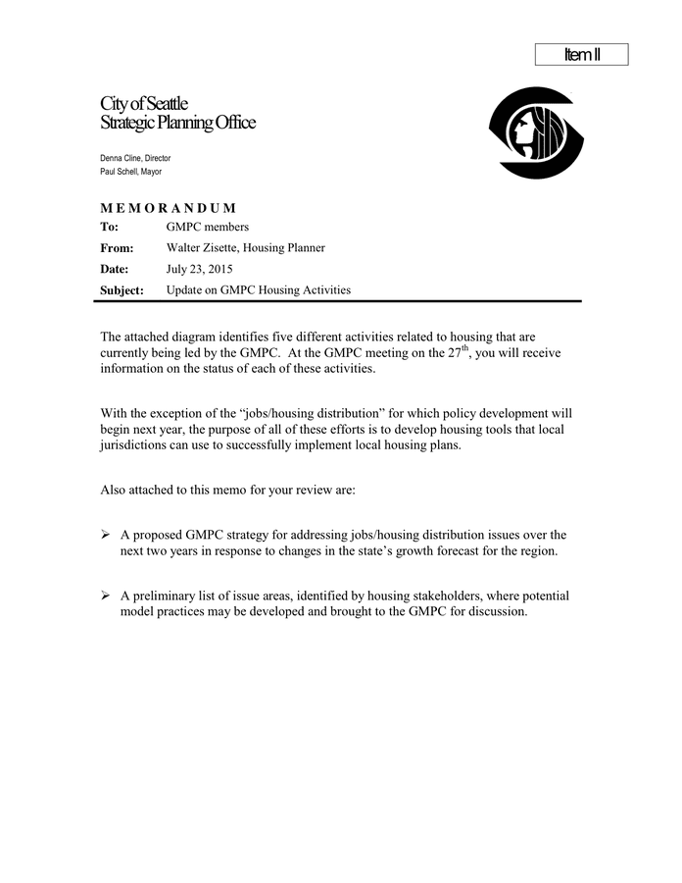

Slide 13
Response to an Inquiry Memo
The purpose of this memo is to provide the audience with desired information.
Structure:
First part states purpose statement, which is to respond to a request.
Second part summarizes the requested information.
Third part has a discussion, highlighting and emphasizing the important information.
Final part is call to action.
Remember to state the additional action to be taken to rightly address the issue.

Slide 14
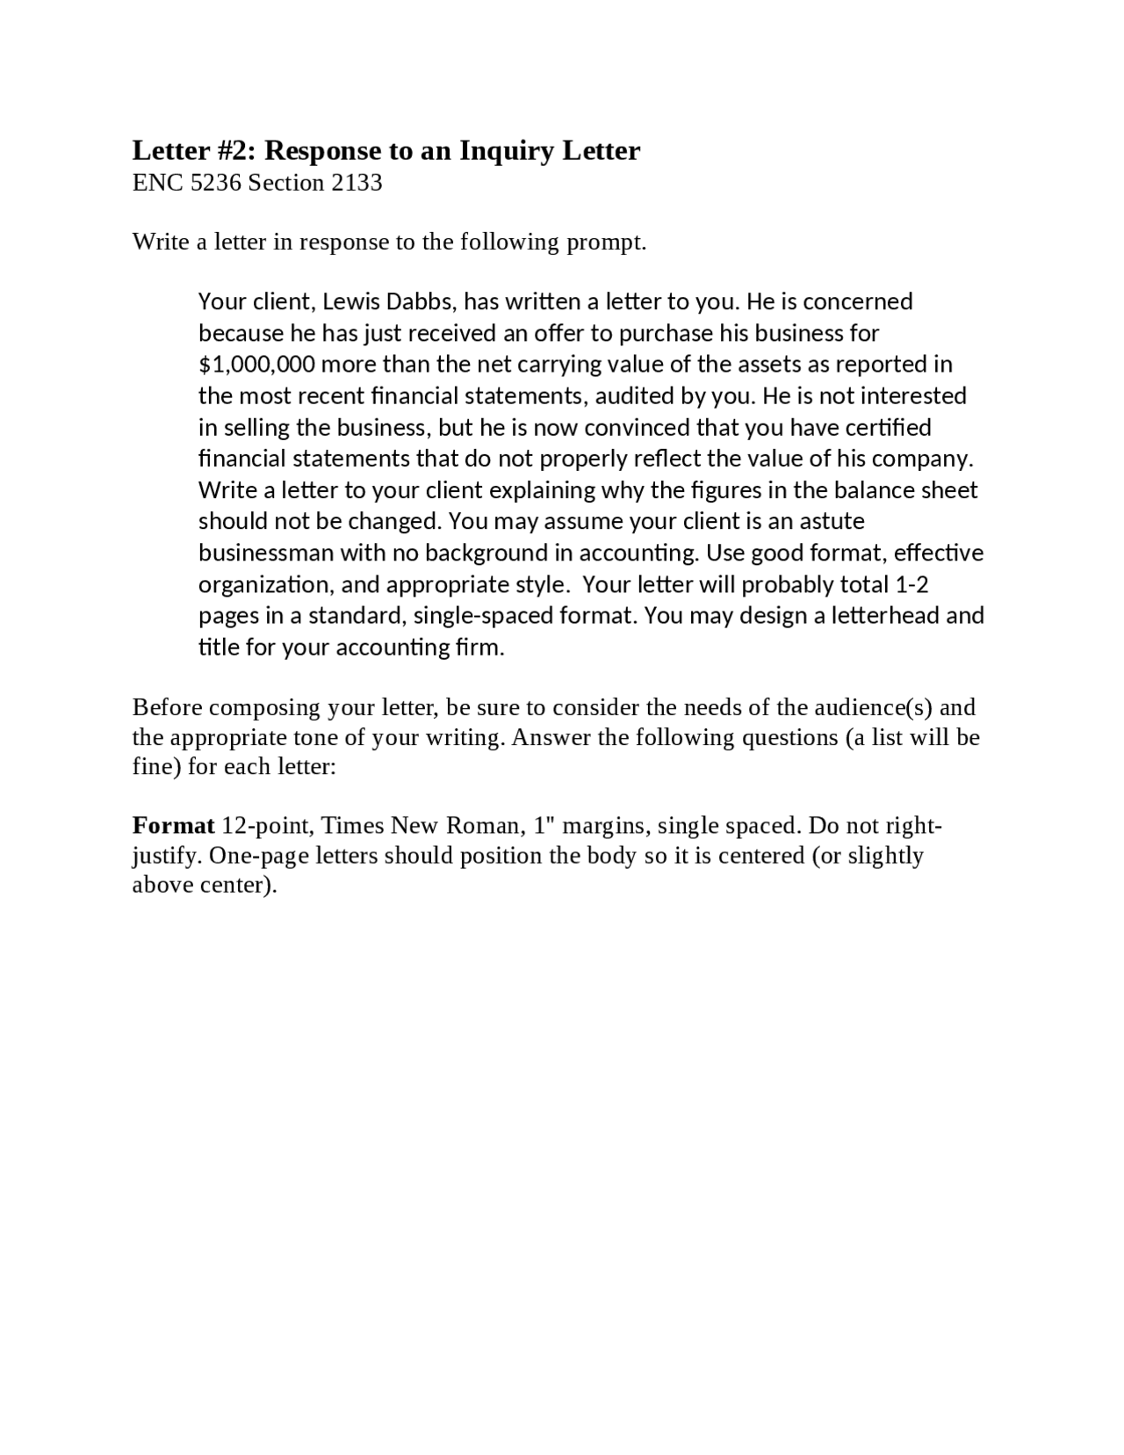

Slide 15
Trip Report Memo
In professional scenarios, a trip memo is used for a supervisor after an employee returns from a business venture.
Structure:
First part has statement of purposes, i.e., provides information on trip.
Second summarizes clearly and concisely (ideally!) outline of your trip.
Third part involves a discussion, which highlights and emphasizes important information.
Final part includes action to be taken to rightly address the issue.

Slide 16
Field Report Memo
Memos are often used to report on inspection and procedures. These memos, known as field or lab reports, include the problem, methods, results, and conclusions, but spend less time on the methods section.
Structure:
Naturally, a field or report memo should begin with a purpose. This varies according to nature of work.
In the next section, a summary of the complete memo should be provided.
Problem leading to the decision to perform the procedure is discussed next followed by methods, results, conclusions and recommendations.

Slide 17
Assignment
Explain the Trip Report Memo and Field Report Memo with examples in the next class.
Class based assignment.

